Slide 1

Csp 584 – Phase 1 Topic - Home Hub to order/search for services, repairs, tools, etc.
Team Members-
Soham satam
Nishant pathare
Ketan pansare

Slide 2
Project scope
Electricians
Repairs and fixes
Electricity Breakdown
Electrical Wiring
Installation service
Plumbers
Pipe/tap fitting
Water leakages
Repairs and fixes
Installation service
Painters
Pest control
Cockroaches and Ants
Bedbugs
Termites
Mosquitoes
Carpenters
Repairs and fixes
New furniture
Appliances (service and repair)
AC
Microwave
Refrigerator
Washing Machine
TV
Cleaning and disinfection
Car
Bathroom
Kitchen
Carpet
Sofa
Full home cleaning
Offices and shops

Slide 3
Flow of the website
Register and login.
Select location (city)
Select the type of service from the category tabs (ex- Electrician etc. )
Select a sub-category (ex- Wiring, Repairs, Installation, Electricity breakdown )
Select a service provider.
Book a suitable time-slot.
Enter the address and contact information.
Enter card details and complete the payment.

Slide 4
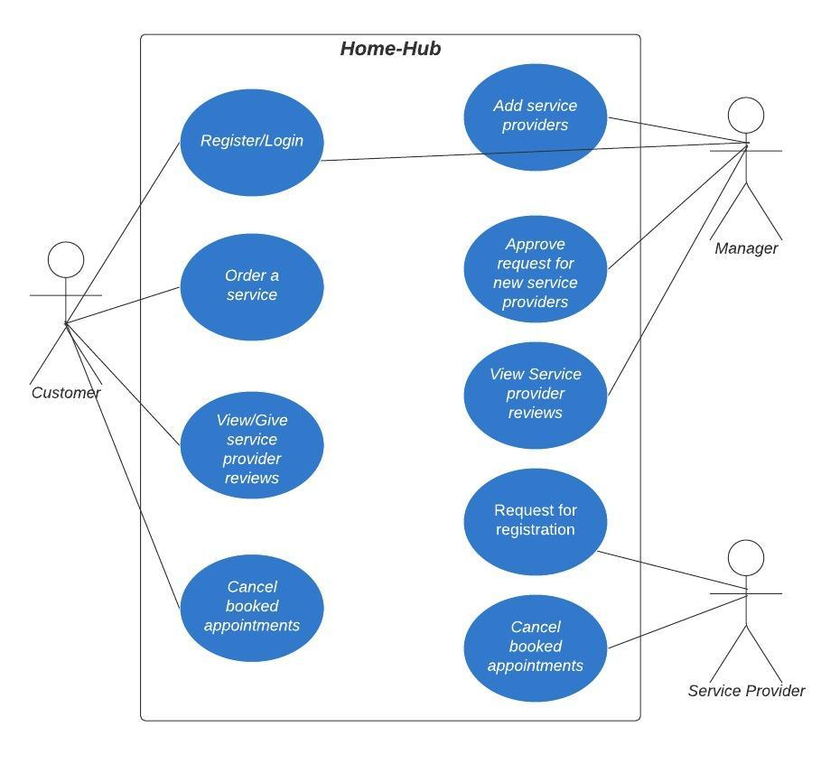
USE CASE DIAGRAM

Slide 5
TECHNOLOGIEs
HTML 5
CSS 3
Javascript
Bootstrap
Java (JSP)
MySQL
MongoDB

Slide 6
THANK YOU!

